Slide 1
Introduction to Wave Optics
Luca Rebuffi (ANL)
Beamline Optics Design and Simulation Workshop
Hamburg, Germany
May 19-22, 2025

Slide 2
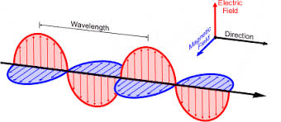
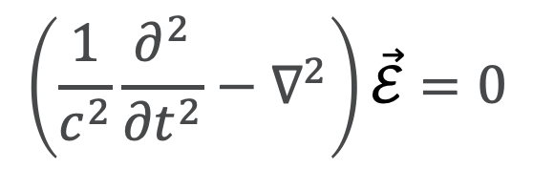
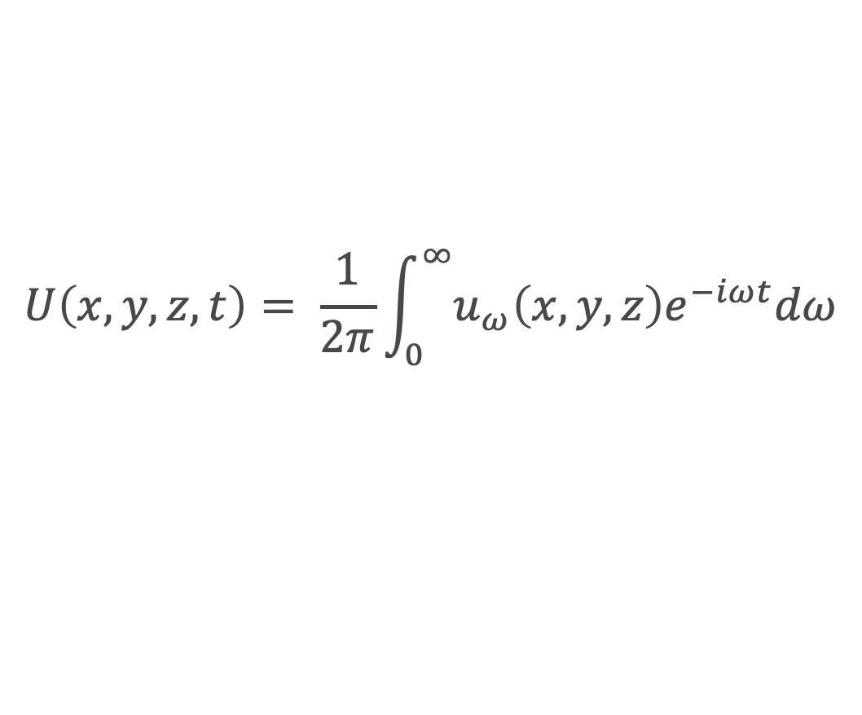
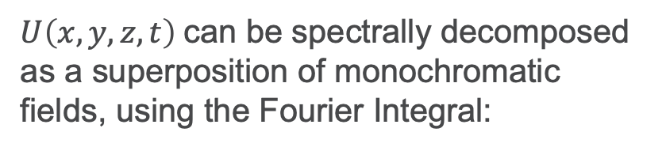
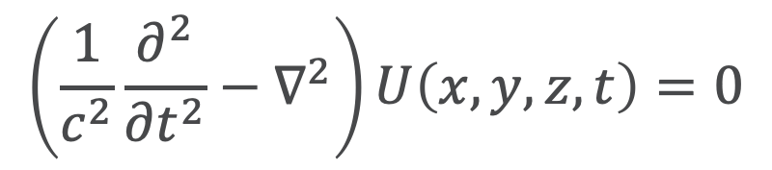
Wavefront Propagation Optical simulations: Wave Optics
From Maxwell equations: wave equation describing spatial and temporal evolution of the electromagnetic fields in free space (D’Alembert equation)
$$\left(\frac{1}{c^{2}}\frac{∂^{2}}{{∂t}^{2}}−∇^{2}\right)\vec{ℰ}=0$$
$$\left(\frac{1}{c^{2}}\frac{∂^{2}}{{∂t}^{2}}−∇^{2}\right)U\left(x, y, z, t\right)=0$$
Scalar theory: describe each component of the fields separately (Electric and Magnetic)
$U\left(x, y, z, t\right)$can be spectrally decomposed as a superposition of monochromatic fields, using the Fourier Integral:
$$U\left(x, y, z, t\right)= \frac{1}{2π}\int_{0}^{∞}{u_{ω}\left(x, y, z\right)e^{−iωt}dω}$$

Slide 3
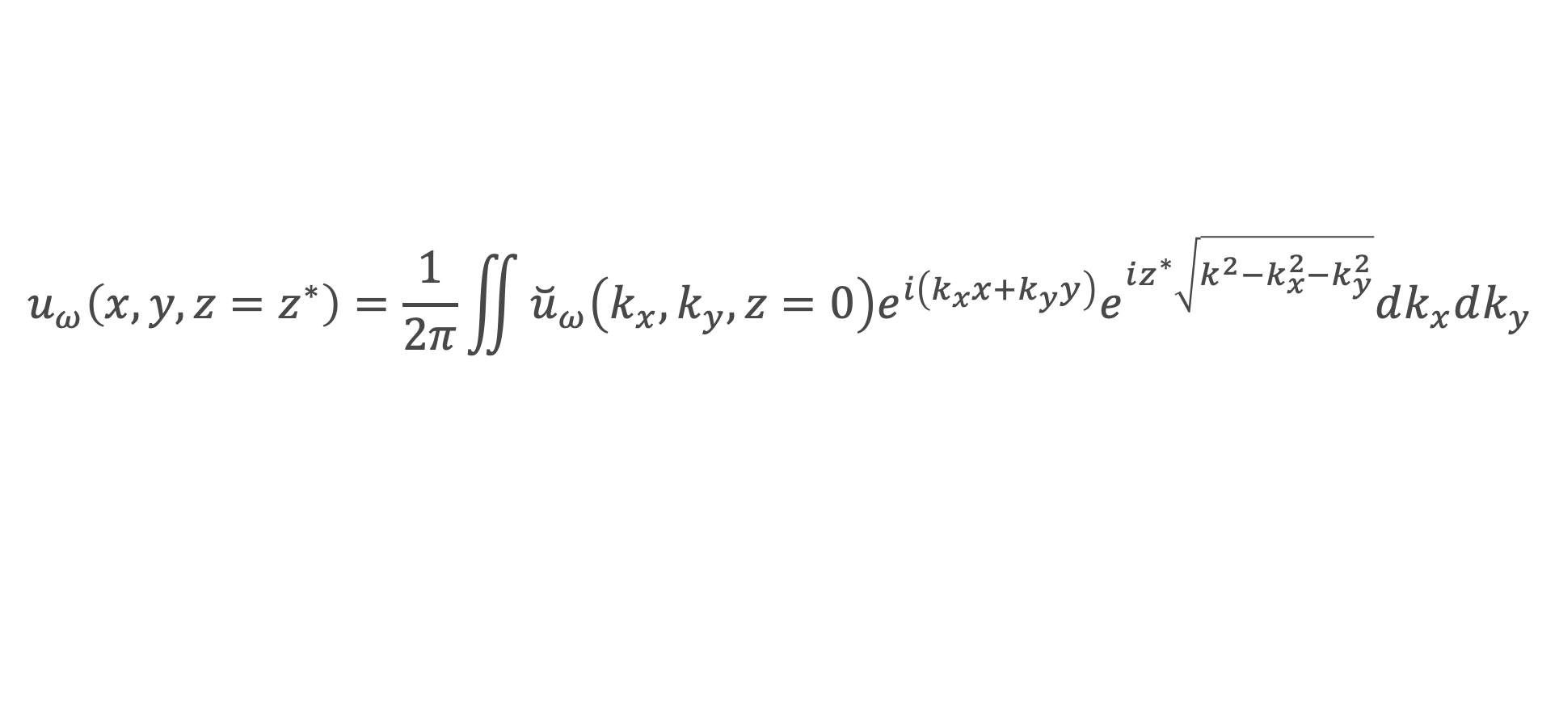
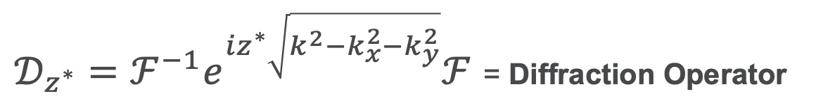
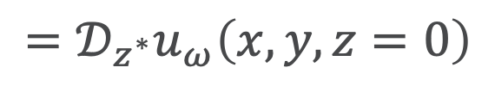

Wavefront Propagation Optical simulations: Wave Optics
The solution for each propagated monochromatic component can be expressed as:
Planar wave at $z=0$
$$u_{ω}\left(x, y, z=z^{∗}\right)=\frac{1}{2π}\iint{{\breve{u}}_{ω}\left(k_{x},k_{y},z=0\right)e^{i\left(k_{x}x+k_{y}y\right)}e^{iz^{∗}\sqrt{{k^{2}−k}_{x}^{2}−k_{y}^{2}}}dk_{x}dk_{y}}$$
Fourier Transform of $u_{ω}\left(x, y, z=0\right)$ with respect $x$ and $y$
Free Space Propagator
$$=𝒟_{z^{∗}}u_{ω}\left(x, y, z=0\right)$$
$𝒟_{z^{∗}}=ℱ^{−1}e^{iz^{∗}\sqrt{{k^{2}−k}_{x}^{2}−k_{y}^{2}}}ℱ$ = Diffraction Operator

Slide 4
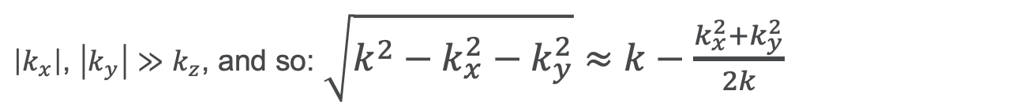
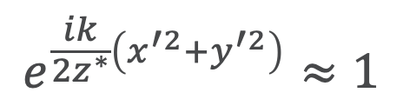
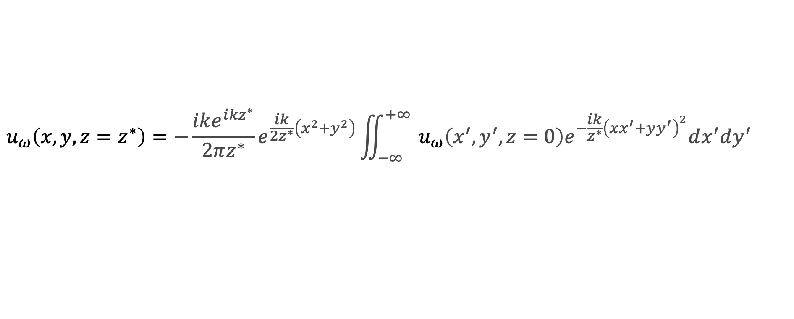
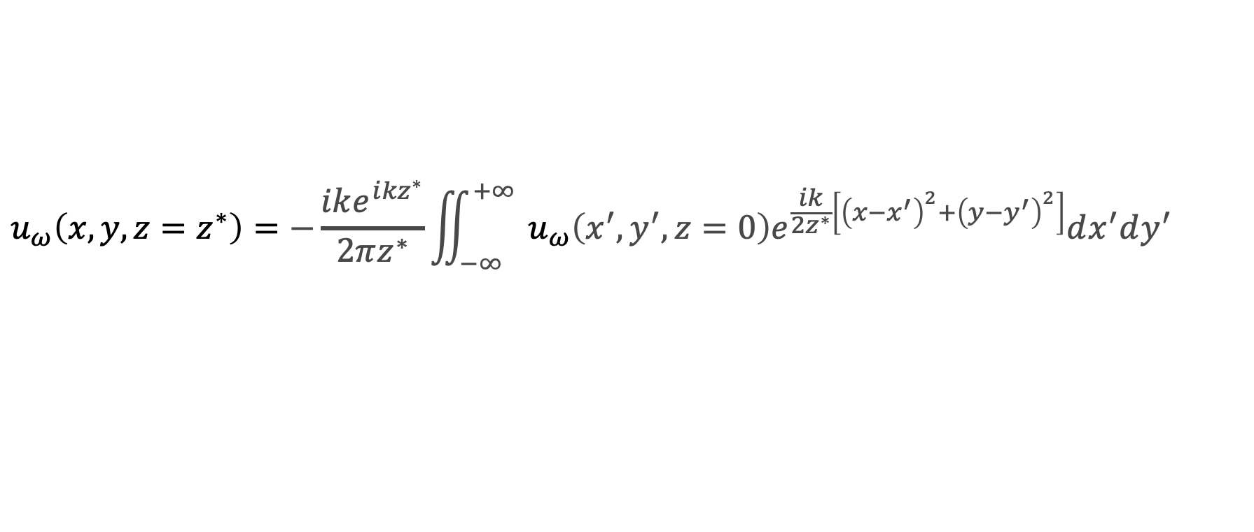
Wavefront Propagation Optical simulations: Wave Optics
Fresnel Approximation (near field)
$\left|k_{x}\right|$, $\left|k_{y}\right|≫k_{z}$, and so: $\sqrt{{k^{2}−k}_{x}^{2}−k_{y}^{2}}≈k−\frac{k_{x}^{2}+k_{y}^{2}}{2k}$
Assumes paraxial approximation: transverse extents of the optical field to be propagated are small compared with the propagation distance
Convolution theorem and some maths
$$u_{ω}\left(x, y, z=z^{∗}\right)=−\frac{ike^{i{kz}^{∗}}}{2πz^{∗}}\iint_{−∞}^{+∞}{{ u}_{ω}\left(x^{′},y^{′}, z=0\right)e^{\frac{ik}{2z^{∗}}\left[{\left(x−x^{′}\right)}^{2}+{\left(y−y^{′}\right)}^{2}\right]}dx^{′}dy^{′}}$$
Fraunhofer Approximation (far field)
Propagated wavefield are at distances that are very large compared to the characteristic length scale of the unpropagated wavefield
$$e^{\frac{ik}{{2z}^{∗}}\left(x^{′2}+y^{′2}\right)}≈1$$
some maths
$$u_{ω}\left(x, y, z=z^{∗}\right)=−\frac{ike^{i{kz}^{∗}}}{2πz^{∗}}e^{\frac{ik}{2z^{∗}}\left(x^{2}+y^{2}\right)}\iint_{−∞}^{+∞}{{ u}_{ω}\left(x^{′},y^{′}, z=0\right)e^{−\frac{ik}{z^{∗}}{\left(xx^{′}+yy^{′}\right)}^{2}}dx^{′}dy^{′}}$$

Slide 5
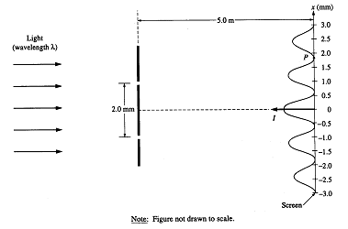
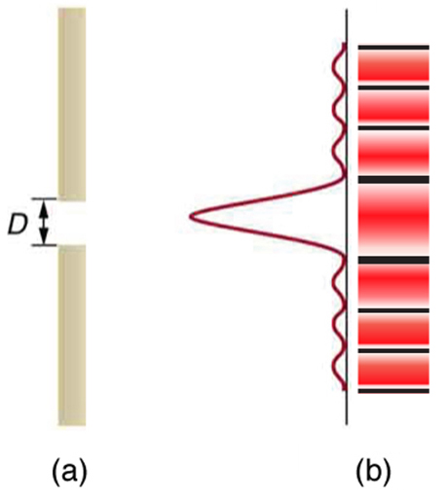
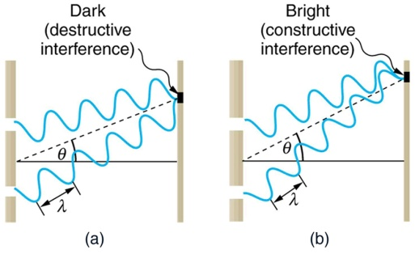
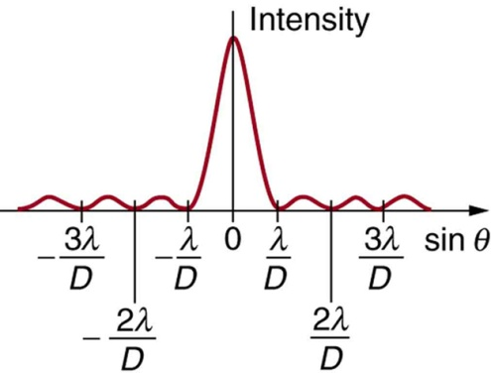

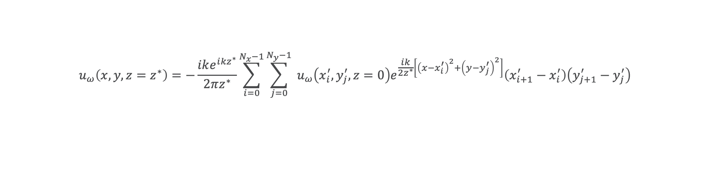
Wavefront Propagation Optical simulations: Wave Optics
Wave optics simulation use numerical integration or Discrete Fourier Transform to solve the integrals
$$u_{ω}\left(x, y, z=z^{∗}\right)=−\frac{ike^{i{kz}^{∗}}}{2πz^{∗}}\sum_{i=0}^{N_{x}−1}{\sum_{j=0}^{N_{y}−1}{{ u}_{ω}\left(x_{i}^{′},y_{j}^{′}, z=0\right)e^{\frac{ik}{2z^{∗}}\left[{\left(x−x_{i}^{′}\right)}^{2}+{\left(y−y_{j}^{′}\right)}^{2}\right]}\left({x_{i+1}^{′}−x}_{i}^{′}\right)\left({y_{j+1}^{′}−y}_{j}^{′}\right)}}$$
numbers of operation = ${\left(N_{x}N_{y}\right)}^{2}$
They allow the simulation of phenomenon like
DIFFRACTION
INTERFERENCE

Slide 6
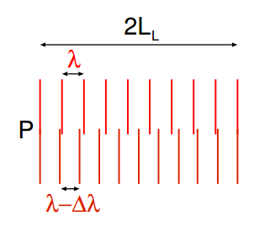
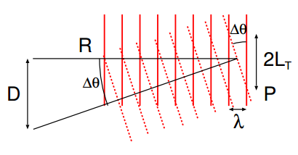
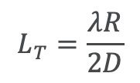
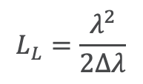
Wavefront Propagation Optical simulations: Wave Optics
A very important aspect embedded in those equation is the possibility to study the Coherence, that describes the correlation between waves at different points:
Temporal coherence describes the correlation or predictable relationship between waves observed at different moments in time.
Spatial coherence describes the correlation between waves at different points in space.
Two waves are in opposite phase at
$$L_{L}=\frac{λ^{2}}{2Δλ}$$
Two waves are in opposite phase at
$$L_{T}=\frac{λR}{2D}$$

Slide 7
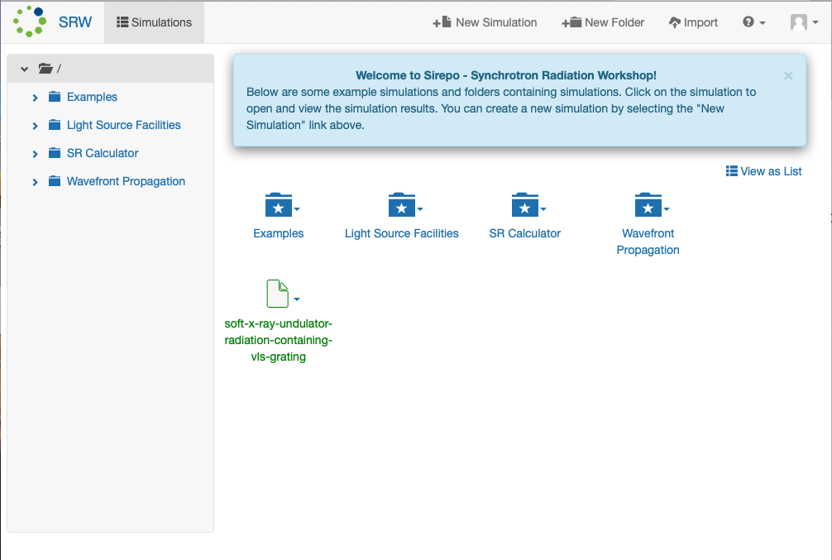
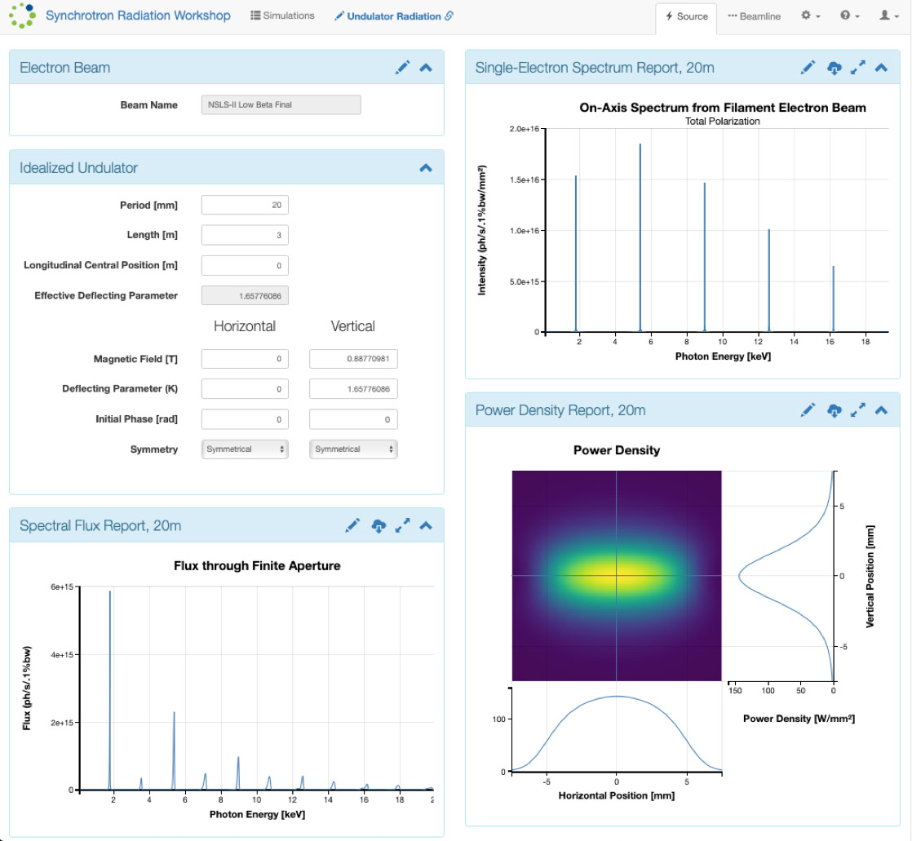


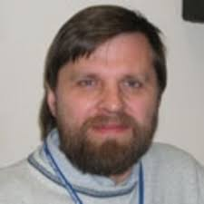

Optical simulations: Syncrotron Radiation Workshop (SRW)
https://github.com/ochubar/SRW
Pascal Elleaume
(✝︎2011)
Oleg Chubar
David Bruhwiler
https://www.sirepo.com

Slide 8
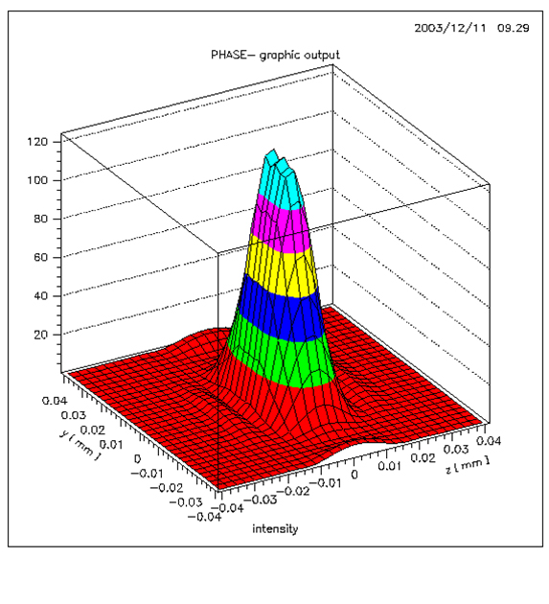
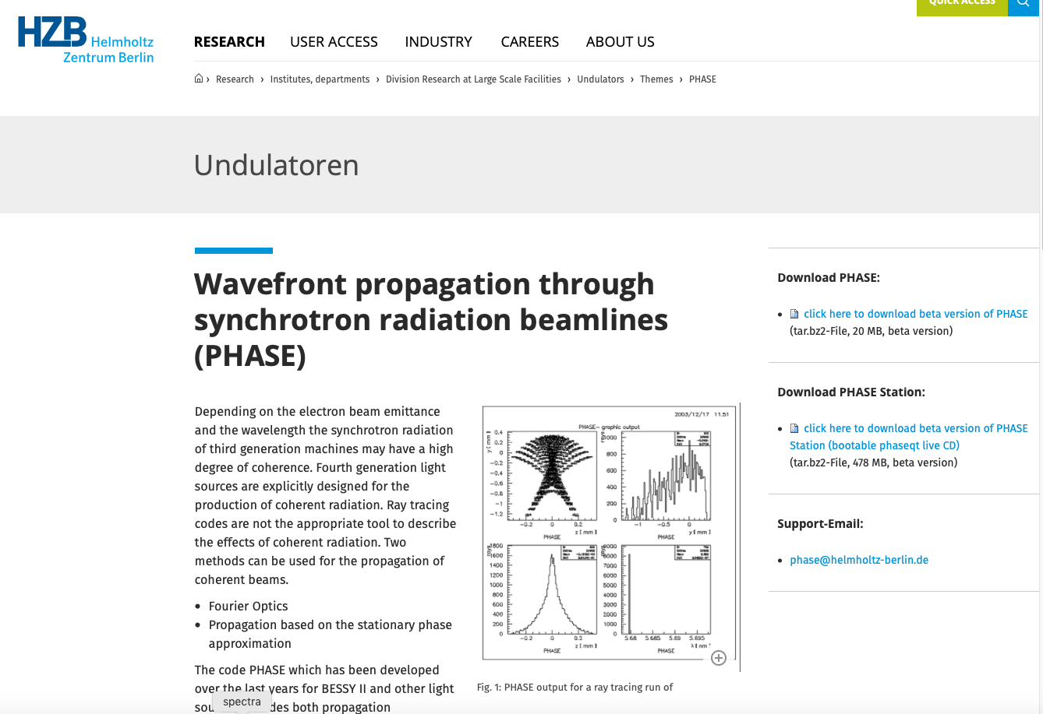
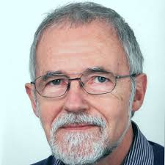
Optical simulations: PHASE
Johannes Bahrdt
https://www.helmholtz-berlin.de/forschung/oe/fg/undulatoren/arbeitsgebiete/phase_en.html

Slide 9
Ideal
Unpolished
Thank you!
Polished
This work was supported by the US Department of Energy, Office of Science, Office of Basic Energy Sciences, under contract DE-AC02-06CH11357.

